Slide 1
2023-04-14

Slide 2
AP CS A Exam
Date of Exam
Wednesday, May 3, 2023 at 12 PM
Section 1: Multiple Choice
40 Questions
90 Minutes
50% of Exam Score
Section 2: Free-Response
4 Questions
90 Minutes
50% of Exam Score
Additional Information and Past Questions
College Board: AP Computer Science A Exam

Slide 3
Upcoming Schedule
Monday | Wednesday | Friday
 |  | 04/14/2023 (90) • Review: Units 1-4 • AP CS Question 1: Methods and Control Structures
04/17/2023 (90) • Review: Unit 5, Unit 9 • AP CS Question 2: Classes | 04/19/2023 (90) • Review: Units 6-7 • AP CS Question 3: Array/ArrayList | 04/21/2023 (45) • Review: Unit 10 • More recursion exercises like we did on Apr-7
04/24/2023 (90) • Review: Unit 8 • AP CS Question 4: 2D Array | 04/26/2023 (90) • AP CS Multiple Choice Game | 04/28/2023 (45) • Review: Unit 7, Unit 10 • Algorithms: Iterative/recursive binary search, selection sort, insertion sort, merge sort
05/01/2023 • FINAL | 05/03/2023 • AP EXAM

Slide 4
Units 1-4
AP CS FRQ 1 (Methods and Control Structures)

Slide 5
Print Statements and Comments
Print something, but do not terminate with a newline ('\n')
System.out.print("Hello, World!");
Print something, terminated by a newline
System.out.println("Hello, World!");
Print just a newline
System.out.println();
Single Line Comments
// comments here
Block Comments:
/* comment starts continues comment ends */

Slide 6
Primitive Data Types
Primitive | Wrapper | Size | Description
byte | Byte | 1 byte | Store integers from -128 (-2⁷) to 127 (2⁷-1)
short | Short | 2 bytes | Store integers from -32,768 (-2¹⁵) to 32,767 (2¹⁵-1)
int | Integer | 4 bytes | Store integers from -2,147,483,648 (-2³¹) to 2,147,483,647 (2³¹-1)
float | Float | 4 bytes | Stores fractional numbers. Sufficient for storing 6 to 7 decimal digits.
double | Double | 8 bytes | Stores fractional numbers. Sufficient for storing 15 decimal digits.
long | Long | 8 bytes | Store integers -9,223,372,036,854,775,808 (-2⁶³) to 9,223,372,036,854,775,807 (2⁶³-1)
boolean | Boolean | 1 bit | Stores true or false
char | Character | 2 bytes | Stores a single 16-bit Unicode character: 'M', '3', '!', 'é'

Slide 7
Variables in Java
There are two types of variables in Java:
Primitive variables
These hold primitive data types like ints, doubles, and booleans.
Autoboxing and Auto-unboxing can automatically convert a primitive to its corresponding Wrapper object and back
Object or Reference variables
These hold a reference to an Object. For example, Strings. A reference is a way to find the object (like the tracking number on a package).
To create a variable you need its data type and name - This is called declaring a variable
type variableName;
Most Java coding-standards prefer camelCase when naming variables.

Slide 8
Variables in Java
The assignment operator in Java is a single equals sign
a = b; // assign b to a
You can combine variable declaration and assignment
type variableName = value;
You can use the final keyword with this form to create a constant that cannot be changed
final type VARIABLE_NAME = value;
Most Java coding standards prefer ALL_CAPS_WITH_SNAKE_CASE when naming constant variables.

Slide 9
Relational Operators
Operator | Meaning | Example
== | Equal To | a == b
!= | Not Equal To | age != 21
> | Greater Than | average > 30
< | Less Than | grade < 60
>= | Greater Than or Equal | age >= 18
<= | Less Than or Equal | height <= 6

Slide 10
Arithmetic Operators
Operator | Meaning | Example
+ | Addition | 3 + x
- | Subtraction | p - q
* | Multiplication | 6 * i
/ | Division | 10 / 4
% | Mod (remainder) | 11 % 3

Slide 11
Compound Assignment Operators
Operator | Example | Compound Assignment Operator | Example
+ | x = x + 3 | += | x += 3
- | x = x - y | -= | x -= y
* | x = x * 5.0 | *= | x *= 5.0
/ | x = x / 2 | /= | x /= 2
% | x = x % 3 | %= | x %= 3

Slide 12
Increment / Decrement Operators
Operator | Equivalent 1 | Equivalent 2 | Example
post-increment | x = x + 1 | x += 1 | x++
post-decrement | y = y - 1 | y -= 1 | y--
Note: pre-increment and pre-decrement operators are also available (not on the AP exam)
int x = 6;
int y = ++x;
System.out.println(x) // Outputs 7
System.out.println(y) // Outputs 7
int x = 6;
int y = x++;
System.out.println(x) // Outputs 7
System.out.println(y) // Outputs 6

Slide 13

Order of Operations
Java evaluates expressions according to standard mathematical rules of precedence.
PEMDAS
• Parentheses • Exponent (ignore this for now) • Multiply / Divide / Modulus • Addition / Subtraction
Java evaluates expressions from left to right and from top to bottom

Slide 14
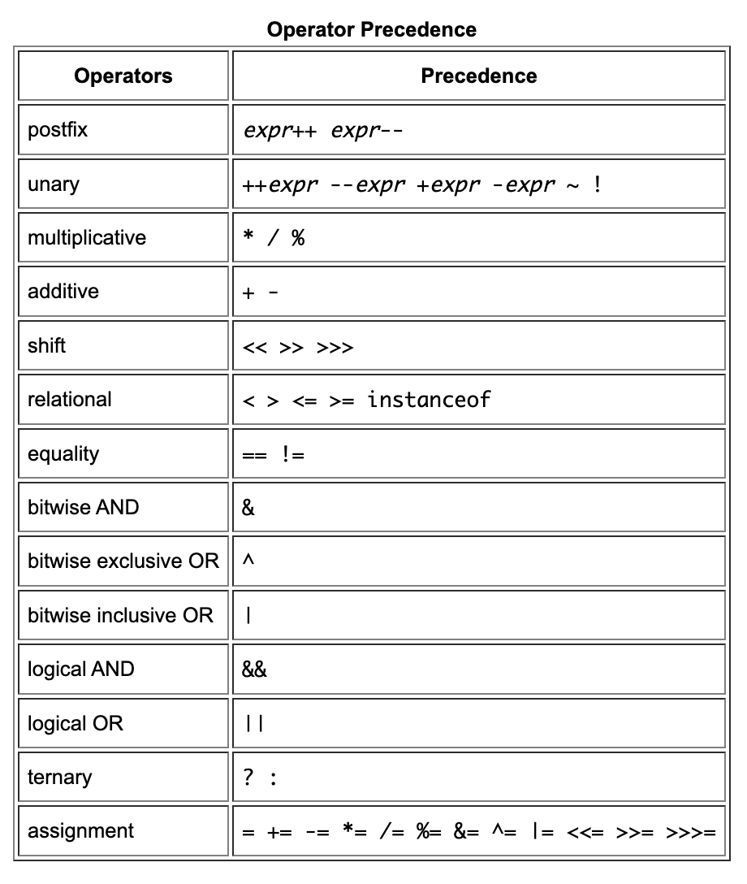
Operator Precedence
Java has an order in which it evaluates operators, just like PEMDAS tells you to multiply/divide before adding/subtracting when doing math.
So x+2 < y+3 and (x+2) < (y+3) are equivalent because + has higher precedence than <.
When in doubt, use parentheses, and sometimes it's best to add parentheses to make code more readable.

Slide 15
Division
Integer Division
Always results in an integer (no decimal; rounded down)
10 / 2 = 5
15 / 2 = 7
19 / 10 = 1
3 / 10 = 0
Double Division
Any double in the expression will cause the result to be a double
10.0 / 2 = 5.0
15.0 / 2 = 7.5
19.0 / 10 = 1.9
3.0 / 10 = 0.3
Average of Integers
(3 + 3 + 11) / 3 = 5 (eh...)
(3 + 3 + 11) / 3.0 = 5.667 (...probably the value you want)

Slide 16
String Concatenation
Same Symbol as Addition (+)
Any string in the expression will cause the result to be a string
"hello " + "friend" == "hello friend"
"your score: " + 100 == "your score: 100"
(78.6 + 10) + " degrees" == "88.6 degrees"
"" + true == "true"
Comparing Strings
String.compareTo() or String.equals() should be used when comparing String objects when you are interested in comparing the contents of the String (usually the case)
bobStr.compareTo("bob")
catStr.equals(dogStr)
Using the equals operator (==) to compare two String objects will determine if the Object references are the same (the variables refer to the same instance of the String Object)

Slide 17
Type Promotion and Type Casting
We have already seen that if an expression combines
An int and a double - the result will be a double
A String and a number - the result will be a String
This is called Type Promotion - and is done automatically by Java to ensure (as much as possible) that you do not accidentally lose precision with your variables
However you can override this in Java by explicitly defining the types you want to use (even if it means losing precision)
This is called Type Casting and the syntax is (type) variableName;
(int) 4.29 // equals 4
(double) 1 // equals 1.0
We will see more of this operator later when we talk about OOP and Inheritance

Slide 18
Classes and Objects (the basics)
A Class in Java is a blueprint for an Object.
It describes the data it will contain - static and instance variables - a.k.a attributes or properties) and the operations (methods) it supports
There is only one Class for a specific type and they do not make use of any program resources
You create an instance of a Class directly via the new keyword (or indirectly via the automatic construction that happen for Strings or for primitive types to their Wrappers).
There can be many instances of a Class and each instance consumes program resources
Java provides thousands of Classes as part of its standard library
Classes are equivalent to types in Java - so a variable that has an Object type can refer to an instance of that Object - uninitialized Object type variables are initialized to null - Which will throw NullPointerException if you try and use it!
type variableName = value; | Planet mars = new Planet("mars"); Planet jupiter; // null

Slide 19
Primitive Wrappers
Primitive | Wrapper
byte | Byte
short | Short
int | Integer
float | Float
double | Double
long | Long
boolean | Boolean
char | Character
Java provides Wrappers for all the primitive types to better facilitate passing information around the Java library (which heavily relies on things being Object types)
The Primitive Wrapper classes are special in that they support auto-boxing, automatic construction of the objects (i.e., you don't need to call the constructor).
Equivalent Examples:
Integer i = 5; | Integer i = new Integer(5);
Boolean b = true; | Boolean b = new Boolean(true);
Character c = 'A'; | Character c = new Character('A');
Double d = 1.256; | Double d = new Double(1.256);

Slide 20
Classes and Objects (the basics)
Properties
Can be public, private, or protected; And static, or non-static
Static properties can be accessed like this
ClassName.propertyName
Non-Static properties (a.k.a instance properties) are accessed like this
classInstance.propertyName
Methods
Can be public, private, or protected; And static, or non-static
Require a return type (can be void if nothing is returned)n
The same method name can occur more than once; But each version of the method must have a unique set of arguments. This is called Method Overloading.
Static methods can be invoked like this
ClassName.staticMethod()
Non-Static methods (a.k.a instance methods) are invoked like this
classInstance.method()

Slide 21
Classes and Objects (the basics)
class Planet { private String name; public Planet(String name) { this.name = name; } public getName() { return name; }
public static int getNumPlanets() { return 8; // sorry Pluto }
}
Planet.getNumPlanets(); // 8
Planet p = new Planet("Mars");
p.getName(); // "Mars" p.getNumPlanets(); // 8

Slide 22
Classes and Objects (the basics)
Method Parameters
Methods can have zero or more parameters
We call them Formal Parameters
When referring to the method parameters in the class definition
public void greet(String name)
We call them Actual Parameters
When referring to the method parameters passed at runtime
amy.greet("Ted")
Method Overloading
The same method name can occur more than once; But each version of the method must have a unique set of argument types (argument names and return types are ignored).
This is called Method Overloading.
public void greet(){}
public void greet(String otherName){}
public void greet(int aNumber){}

Slide 23
Classes and Objects (the basics)
Methods vs Functions
A method represents an action supported by some class of object in Object-Oriented Programming (OOP). Java is an OOP language. Some programming languages have functions. Some have methods. Some have functions and methods!
In Java, there are only methods; Every method belongs to a class.
Returning From A Method
Use the return keyword to return a value from a Method; Java only allows a single value to be returned from a Method (although as we will see later you could return an Array or ArrayList that itself is a single value - but contains multiple values)
Every Method that has a non-void return type must return a value; And that value must have the type specified as the return type in the Method signature; You can call return with no argument if the Method return type is void and it is useful for the flow of your program
VALID | INVALID (WHY?)
public int getNumberTimesThree(int value) { return 3.0 * value; } | public int getNumberTimesThree(int value) { return 3.0 * value; }

Slide 24
this is a reference to the current object instance
class Student { private String name; private int age;
Student(String name, int age) { this.name = name; this.age = age; } public String toString(){ return name; } } class HelloWorld { public static void main( String args[] ) { Student s = new Student("Jane",16); System.out.println(s.toString()); //”Jane” System.out.println(s); //Also ”Jane” } }
Student s
Call Stack
VERY common
pattern.
"Jane"
name
s.toString()
16
age
this
Q: What's the difference here between name and this.name?
main(new String[]{})
args
new String[] {}
s

Slide 25
The String Class
Strings in Java are instances of the java.lang.String class that hold sequences of characters (a, b, c, $, etc.). The parent class of java.lang.String is java.lang.Object, which is the top-most parent class of all Java classes.
Strings in Java are IMMUTABLE - they cannot change. If you want to make use of a MUTABLE string then you can use java.lang.StringBuilder
Strings can be appended to each other to create a new string using the + or += operator. This is also called concatenation.
In many other languages, like JavaScript and Python, you can use the == operator to compare strings for equality.
In Java, the == operator compares object references, not what’s in the referenced objects!
s1.equals(s2) is almost always what you want, not s1 == s2

Slide 26
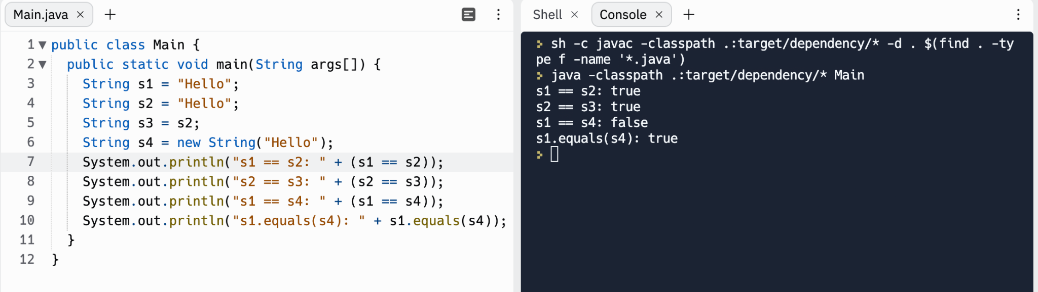
s1
s2
s3
s4
String literal “Hello”
Java Language Standard 15.29:
Constant expressions of type String are always "interned" so as to share unique instances, using the method String.intern.
new String(“Hello”)

Slide 27
String Class Methods (some of them)
Return Type | Method Name | Formal Arguments | Example
int | length | N/A | s.length()
String | substring | int from, int to | s2 = s1.substring(1,3)
int | indexOf | String str | idx = s.indexOf("cat")
int | compareTo | String str | iRes = s.compareTo("Bob")
boolean | equals | String other | b = s.equals("dog")
boolean | isEmpty | N/A | b = s.isEmpty()
Remember: Like most "indexed" structures in Java
String indices start at zero and the last element index will be length-1

Slide 28
The Math Class
Provides standard mathematical functions and constants.
Math has only static methods and attributes. It cannot be instantiated with the new operator… it has no public constructor!

Slide 29
Math Class Methods (some of them)
Return Type | Method Name | Formal Arguments | Example
int | abs | int x | Math.abs(-123)
double | abs | double x | Math.abs(-123.25)
double | pow | double base, double exp | Math.pow(2,10)
int | sqrt | int x | Math.sqrt(16)
double | random | N/A | d = Math.random()
Write code that generates a random int between 0 to 9
int random = (int) (Math.random() * 10);
Write code that generates a random int between 1 and 10
int random = (int) (Math.random() * 10) + 1;

Slide 30
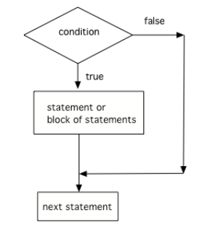
Control Flow: if statement
if (boolean expression) { statements }
next statement
Curly braces are not required for a single statement.
(Curly braces around one statement is really a one-statement block.)
But we recommend it, and it's common to many Java coding standards.

Slide 31
Control Flow: if-else statement
Does boolean expression evaluate to true?
// Condition if (boolean expression) {
then-statements
} else {
else-statements }
next-statements
No
Yes
Execute then-statements
Execute else-statements
next-statements after if…else

Slide 32
Control Flow: else-if
Does boolean expression 1 evaluate to true?
if-else statements can be chained together to handle many alternative cases.
if (boolean expression 1) {
statements-1
} else if (boolean expression 2) {
statements-2 } else { statements-3
}
next-statements
No
Yes
Does boolean expression 2 evaluate to true?
No
Yes
Execute statements-1
Execute statements-2
Execute statements-3
next-statements

Slide 33
Control Flow: Nesting
Reminder: if statements and if-else statements are statements; so, they can become the statements inside other if or if-else statements! Always double-check your curly-braces because spacing doesn't mean anything to the Java compiler!
if (boolean expression) {
if (boolean expression) {
if (boolean expression) {
<statement>;
…
} else {
<statement>;
…
}
}
} else {
<statement>;
…
}

Slide 34
Dangling Else
int x = 0;
if (x >= 0)
if (x > 0)
System.out.println("x is positive");
else
System.out.println("x is negative");
is paired with this if
this else
Prints "x is negative"!
The else clause will always be a part of the closest if statement if in the same block of code regardless of indentation… Unless you use {}!

Slide 35
Logical Operators
Logical And
p && q
Evaluates boolean expressions p and q.
Evaluates to true if p and q are both true, false otherwise.
if (sunny && warm) { … }
Logical Or
p || q
Evaluates boolean expressions x and y.
Evaluates to true if p or q are true, false otherwise.
if (christmas || halloween) { … }
Logical Not
!p
Evaluates boolean expression p.
Evaluates to true if p is false.
Evaluates to false if p is true.
if (!day.equals("Sunday")) { … }
Why p and q? In logic textbooks, the "default" names for logical propositions are p and q.

Slide 36
Truth Table - &&
Truth Table - ||
Truth Table - !
p | q | p && q
true | true | true
true | false | false
false | true | false
false | false | false
p | q | p || q
true | true | true
true | false | true
false | true | true
false | false | false
p | !p
true | false
false | true

Slide 37
Short-Circuit Evaluation with &&
Does p evaluate to true?
No
Yes
p && q
Does q evaluate to true?
No
Yes
true
false

Slide 38
Short-Circuit Evaluation with ||
Does p evaluate to true?
Yes
No
p || q
Does q evaluate to true?
Yes
No
false
true

Slide 39
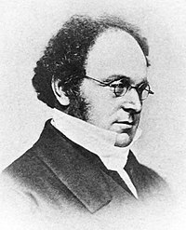

De Morgan's Laws
Augustus De Morgan (27 June 1806 – 18 March 1871) was a British mathematician and logician. He formulated De Morgan's Laws.

Slide 40
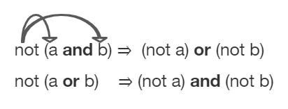
DeMorgan's Laws
Rules by which we can simplify Booleans to make them easier to read or interpret

Slide 41
DeMorgan's Laws
In Java:
!(a && b) is equivalent to !a || !b
!(a || b) is equivalent to !a && !b
a | b | !(a && b) | !a || !b
T | T | F | F
T | F | T | T
F | T | T | T
F | F | T | T

Slide 42
Iteration and Looping: while statement
while (boolean expression) {
statements
}
Example:
int i = 1;
while (i <= 100) {
System.out.println(i);
i++;
}
Does boolean expression evaluate to true?
Yes
No
Execute statements
Next statement after while

Slide 43
Iteration and Looping: do-while statement
do {
statements
} while (boolean expression)
Example:
String name;
do {
System.out.println("Enter your name.");
name = scanner.nextLine();
} while (name.length() == 0);
Execute statements
Does boolean expression evaluate to true?
Yes
No
Next statement after do…while

Slide 44
Iteration and Looping: for statement
Evaluate initialization expression
for (initialization; condition; increment) {
statements
}
Example:
for (int i = 1; i <= 100; i++) {
System.out.println(i);
}
Does condition evaluate to true?
Yes
No
Execute body statement
Next statement after for
Evaluate increment expression

Slide 45
Iteration and Looping
Infinite Loop | Occasionally Useful; But beware of the accidental Infinite Loop while (true) { handleNextRequest(); }
break while, do-while, for, for-each | Exit the current loop for (int i = 1; i <= 100; i++) { if (55 == i) { break; } System.out.println(i); }

Slide 46
Iteration and Looping
continue while, do-while, for, for-each | Jump to the beginning (or the end for do-while) and evaluate the condition (or the next item for for-each for (int i = 1; i <= 100; i++) { if (0 == i % 2) { continue; } System.out.println(i); }
return | Return immediately from the current method

Slide 47
AP CS FRQ 1 (25 minutes)
2022 AP Computer Science A - Free-Response Questions
Complete (1.A) and (1.B)

Slide 48
AP CS FRQ 1 - Review (15 minutes)
Sample Responses and Scoring Commentary - FRQ-1

